Slide 1

System “High-level” Flow
Browser
Client’s Web server
MAC OTP Server
Send OTP Request (transaction details)
Verify OTP Request
Send SMS Message, Phone Number
Text message containing OTP, transaction details, Ad Link
Text message containing OTP, transaction details, Ad Link
Message Broadcast

Slide 2
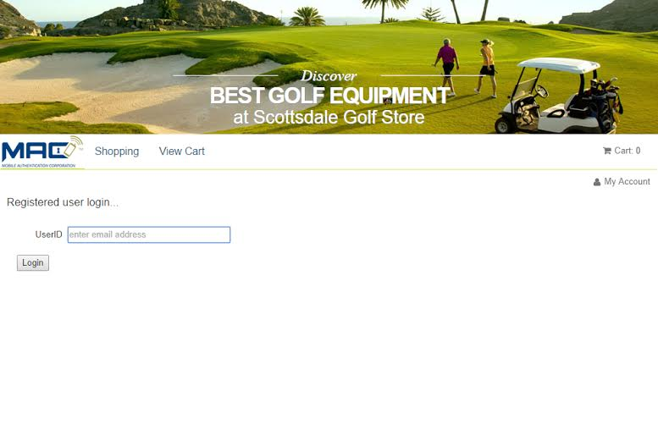
User Authentication
Example Login Page for Online Merchant
Description:
Enter login (email for this example)
Button click to start the login process

Slide 3
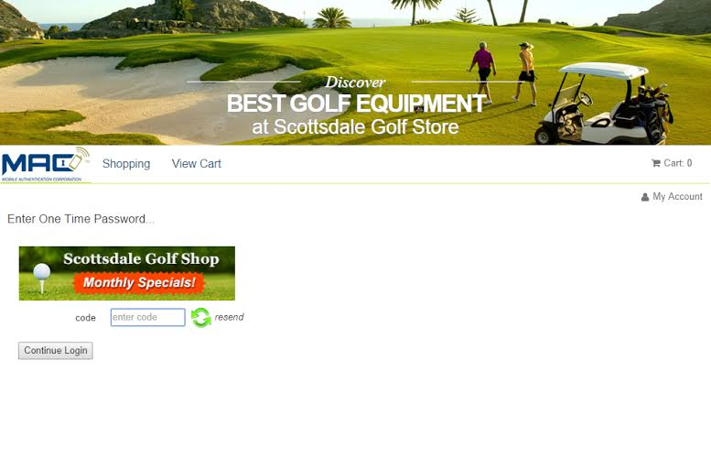
User Authentication
Example Enter One-Time Password Page
Description:
Display Ad
Resend OTP if needed
OTP entry text box
Button click to authenticate user

Slide 4
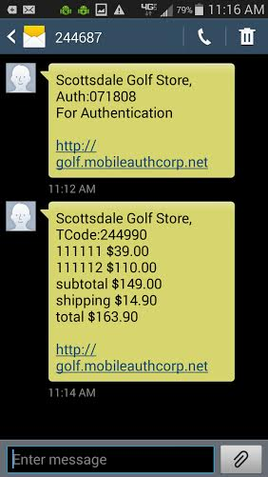
User Authentication
Example Text Messages Enter
User Authentication Message
Client Name, Merchant or Financial Institution, fixed from client configuration
Label, fixed from client configuration, One-time password that is
dynamically generated at time of authentication request
Description, fixed based on message type, Client configuration
Ad link, Predefined by client
Note: No opt out reply because the user has to sign up
for the service at the Merchant’s or Financial institution’s web site.

Slide 5
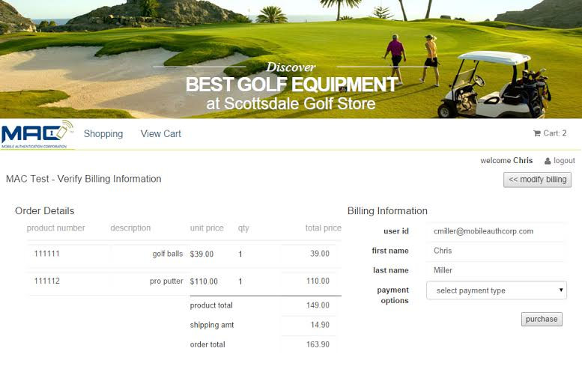
Transaction Verification and Authorization
Example Online Merchant Checkout Page

Slide 6

Transaction Verification and Authorization
Example Transaction Verification Page
Description:
Display Ad
Transaction details (Client defined)
Resend OTP if needed
OTP entry text box
Button click to Authorize transaction

Slide 7
Transaction Verification and Authorization
Example Text Message Enter
Transaction Verification Message
Client Name - Merchant or Financial Institution
Label - from client configuration, One-time password - Dynamically
generated at time of transaction verification request
Brief Transaction details - Supplied by Merchant or Financial Institution
with the request for one-time password.
Ad link - Predefined by client
Note: No opt out reply because the user has to sign up
for the service at the Merchant’s or Financial institution’s web site.

